Slide 1
BLG 433E COMPUTER COMMUNICATIONS: SOCKET TUTORIAL
Instructor: Prof. Sema F. OKTUĞ
Teaching Assistant: Yusuf ÖZÇEVİK
FALL 2018-2019

Slide 2
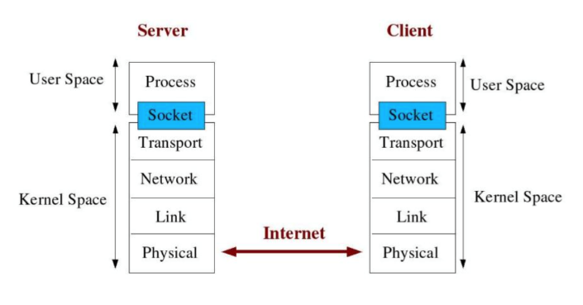
What is Socket & Port?
Socket is interface between Application and Transport layer
The application process can send/receive messages to/from another application process (local or remote)via a socket

Slide 3
What is Socket & Port?
Multi process can be on internet from one computer (same IP address)
There should be different Ports
Internet sockets characterized by IP Address (4 bytes) and port number (2 bytes)
Port number → 0 to 65536
Web sites: HTTP , port # = 80, over TCP
E-mail: POP3, port #=110, over TCP

Slide 4
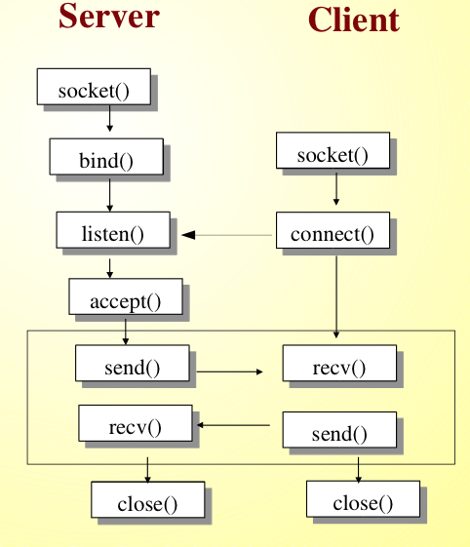
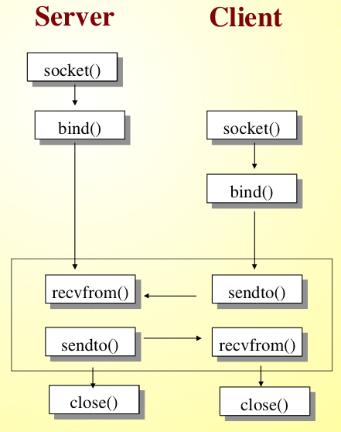
Socket Programming Internet Socket Types
Stream Socket (SOCK_STREAM)
Connection Oriented-Over TCP
Datagram Socket (SOCK_DGRAM)
Connectionless-Over UDP

Slide 5
Socket Programming
socket() → Get the file descriptor
bind() - what port am I on?
connect() - Hello!
listen() - Call me please!
accept() - Thank you for calling !
send() and recv() - Let's talk!
sendto() and recvfrom()-DGRAM style
close()→bye bye!

Slide 6
Questions
R6. Suppose you wanted to do a transaction from a remote client to a server as fast as possible. Would you use UDP or TCP? Why?

Slide 7
Questions
R26. InSection2.7, the UDP server described needed only one socket, where as the TCP server needed two sockets. Why? If the TCP server were to support n simultaneous connections, each from a different client host, how many sockets would the TCP server need?

Slide 8
Questions
R27. For the client-server application over TCP described in Section 2.7, why must the server program be executed before the client program? For the client- server application over UDP, why may the client program be executed before the server program?

Slide 9
Questions
P31. Install and compile the Python programs TCPClient and UDPClient (in Example 1) on one host and TCPServer and UDPServer on another host.
Suppose you run TCP Client before you run TCP Server. What happens? Why?
Suppose you run UDP Client before you run UDP Server. What happens? Why?

